Slide 1
Financial Performance and Cash Flow Analysis of Tata Motors Using Microsoft Power BI
Syeda Nasreen Minaaz
Enrollment No: O24MSD110213
MSc Data Science

Slide 2
Introduction
Business Intelligence (BI) has become an essential tool for organizations seeking to make data-driven decisions. Modern businesses generate large volumes of data that require effective analysis and visualization to support strategic planning and performance monitoring.
Microsoft Power BI is a powerful Business Intelligence platform that enables users to collect, transform, analyze, and visualize data through interactive dashboards and reports. It helps organizations convert complex datasets into meaningful insights.
This project focuses on analyzing the financial performance of Tata Motors using Microsoft Power BI. Financial indicators such as revenue, net profit, operating cash flow, total assets, and employee growth are analyzed to evaluate the company's performance over multiple financial years.

Slide 3
Problem Statement
Traditional financial reporting methods rely heavily on spreadsheets and static reports, making data analysis time-consuming and difficult to interpret. Large volumes of financial information often require manual calculations and extensive review, which can delay decision-making and increase the risk of errors.
There is a need for an interactive and visual reporting solution that can simplify financial analysis, improve reporting efficiency, and provide actionable business insights.
The proposed solution uses Microsoft Power BI to transform Tata Motors' financial data into dynamic dashboards that support better financial analysis and decision-making.

Slide 4
Objectives
Project Objectives
Analyze Tata Motors' financial performance using Microsoft Power BI.
Evaluate revenue growth trends across multiple financial years.
Analyze net profit and profitability performance.
Examine operating cash flow patterns.
Assess asset growth and organizational expansion.
Monitor employee growth trends.
Create interactive dashboards and visual reports.
Demonstrate the practical application of Business Intelligence tools.
Support data-driven decision-making through visual analytics.

Slide 5
Dataset
Company Overview - Tata Motors
Tata Motors Limited is one of India's largest automobile manufacturers and a flagship company of the Tata Group. Established in 1945, the company has grown into a global automotive organization with operations in passenger vehicles, commercial vehicles, electric vehicles, and luxury automobiles.
Key Highlights
Founded: 1945
Headquarters: Mumbai, India
Parent Group: Tata Group
Industry: Automotive Manufacturing
Global Presence: Over 125 countries
Major Brands: Tata Motors, Jaguar Land Rover (JLR)
Business Segments
Passenger Vehicles
Commercial Vehicles
Electric Vehicles
Luxury Vehicles (Jaguar Land Rover)
Tata Motors is recognized for innovation, sustainability initiatives, and its contribution to the growth of the Indian automotive industry.

Slide 6
System Architecture
Excel → Power Query → Data Model → DAX → Dashboard → Insights

Slide 7
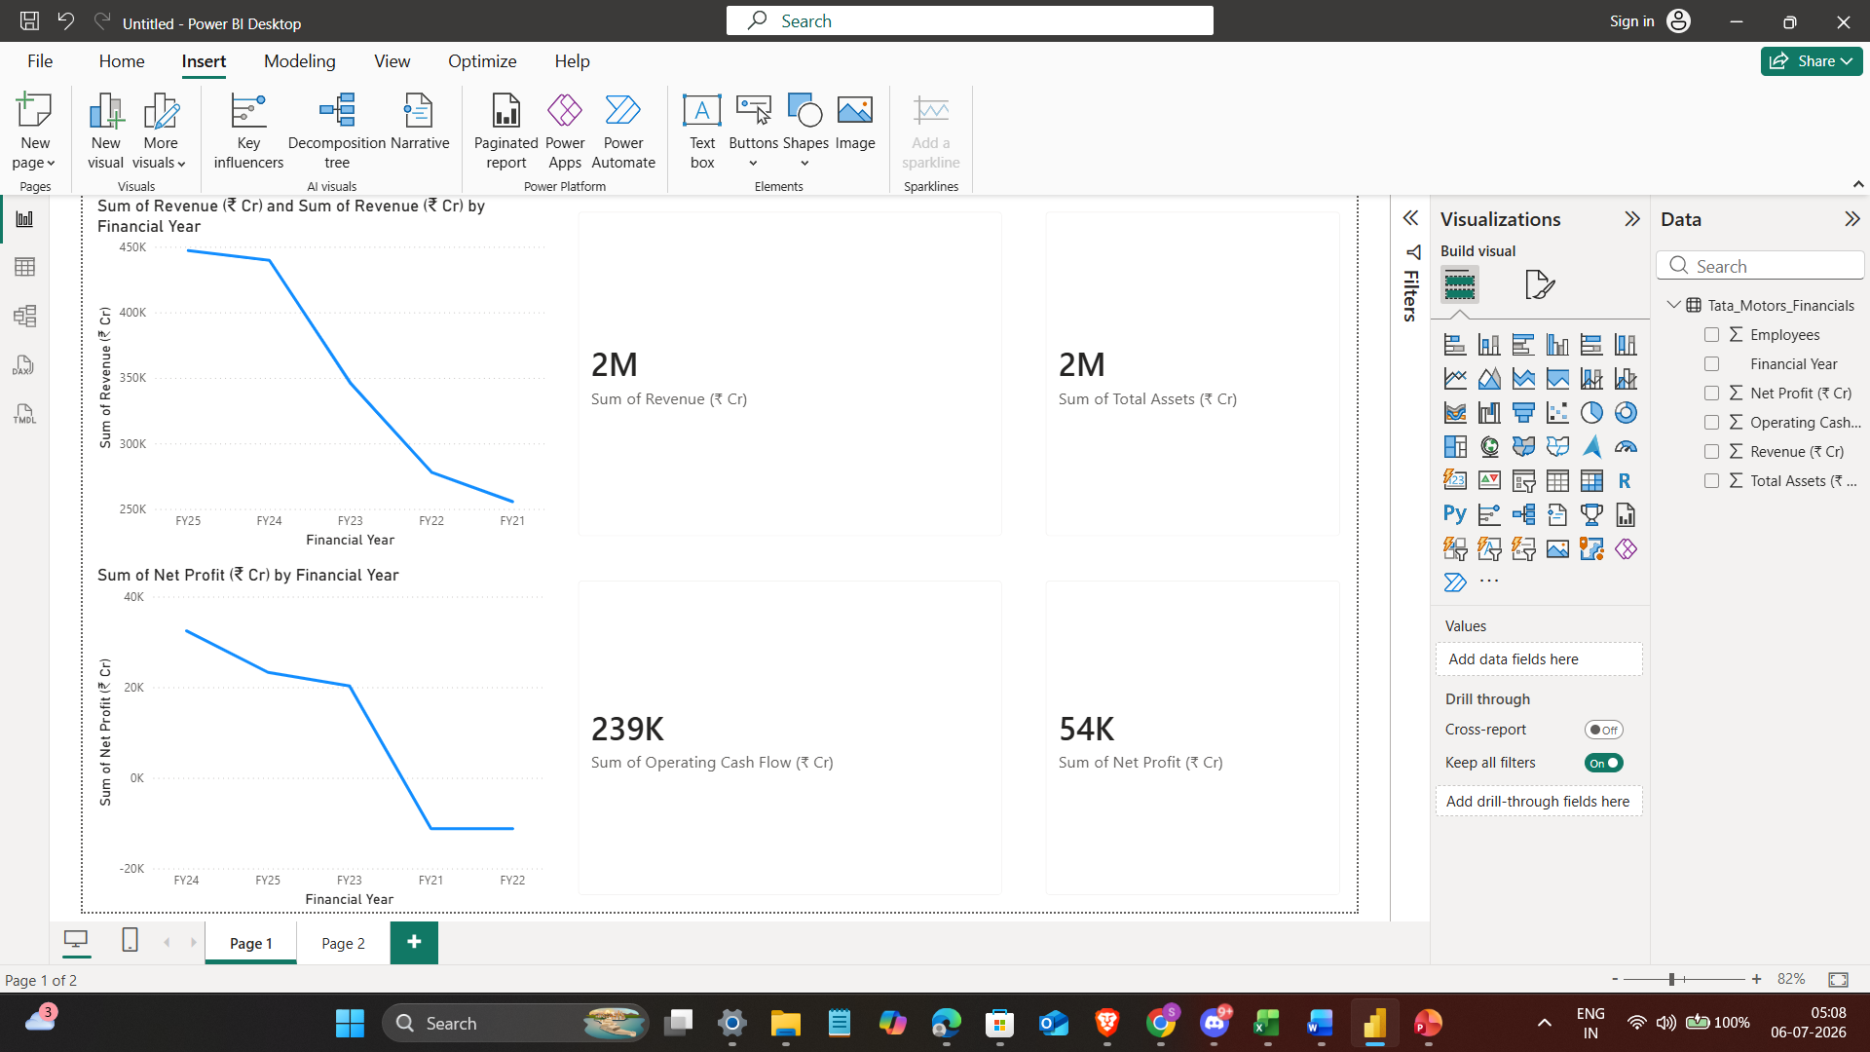
Dashboard Overview
Insert dashboard screenshot.

Slide 8
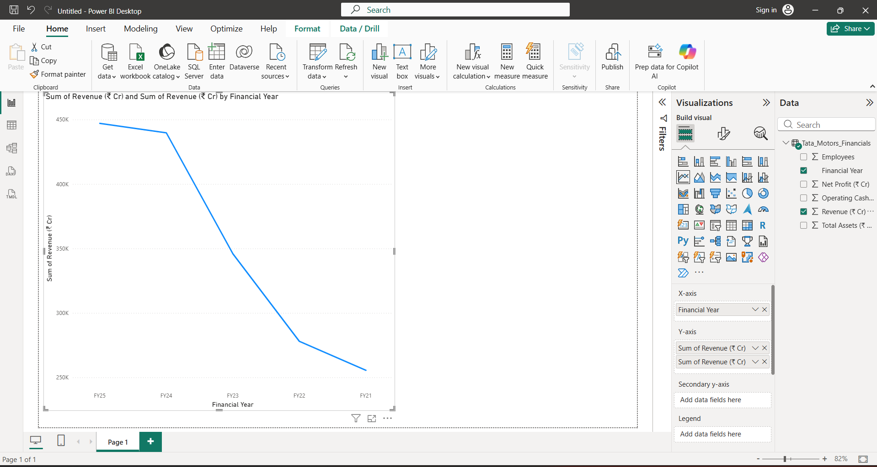
Revenue Analysis
Revenue trend analysis.

Slide 9
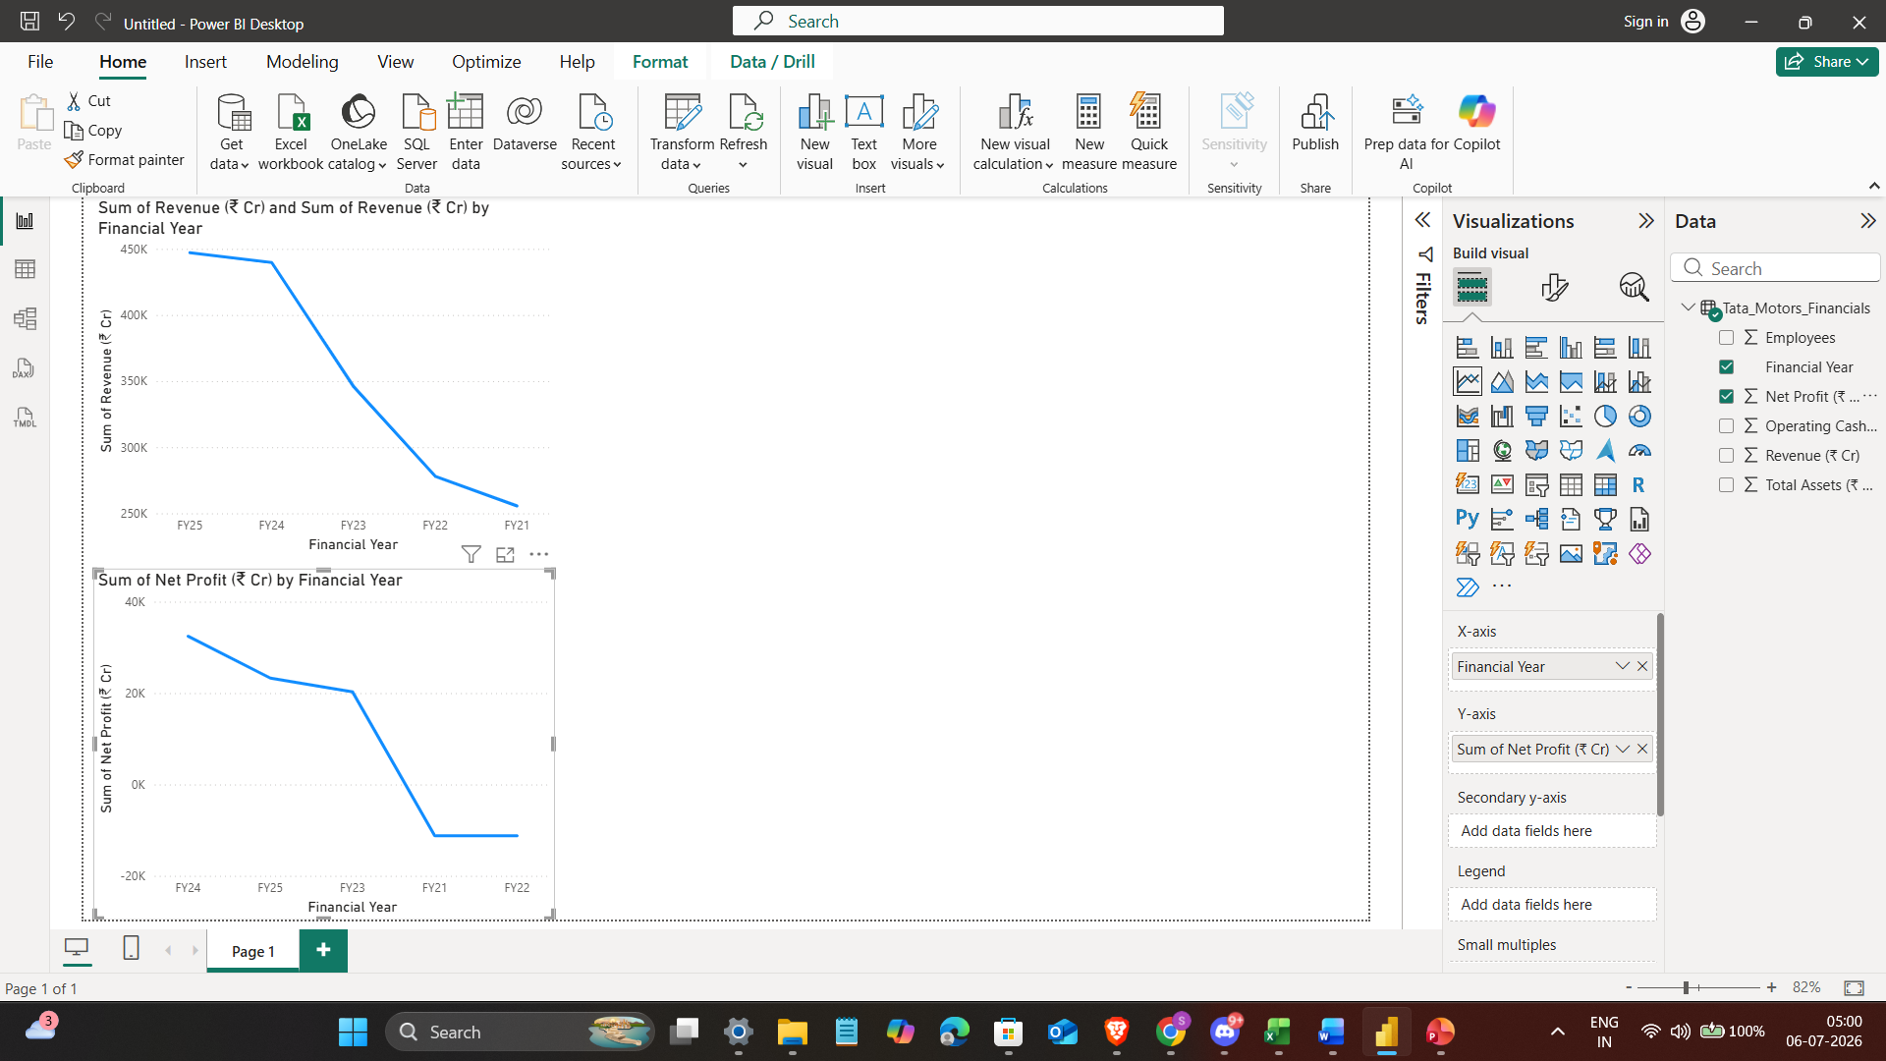
Profit Analysis
Profit trend analysis.

Slide 10
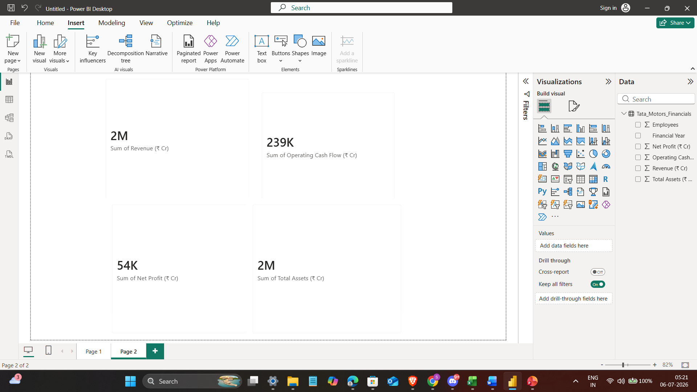
Cash Flow Analysis
Cash flow trend analysis.

Slide 11
Results
Key Findings
Revenue increased from ₹255,552 Cr (FY21) to ₹447,107 Cr (FY25), indicating strong business growth.
Net Profit improved from losses in FY21 and FY22 to positive profitability from FY23 onward.
Operating Cash Flow increased consistently, demonstrating improved liquidity and financial stability.
Total Assets grew from ₹320,000 Cr to ₹440,000 Cr, reflecting organizational expansion and investment.
Employee strength increased steadily, supporting business growth and operational capacity.
Interactive Power BI dashboards simplified financial analysis and improved reporting efficiency.
Business Insights
Tata Motors showed significant recovery and growth during the study period.
Financial performance improved due to better profitability and cash flow management.
Visual analytics enabled faster identification of trends and performance patterns.
Power BI proved effective for financial reporting and data-driven decision-making.

Slide 12
Conclusion
Power BI improved financial reporting and analysis.

Slide 13
Future Scope
Future Scope
Integration of real-time financial data sources for live reporting.
Implementation of Artificial Intelligence (AI) for financial forecasting.
Use of Machine Learning models to predict revenue, profit, and cash flow trends.
Development of automated reporting systems to reduce manual effort.
Integration with cloud-based analytics platforms for enterprise-wide access.
Mobile-friendly dashboards for anytime, anywhere access.
Advanced predictive analytics for strategic business planning.
Expansion of the dashboard to include competitor and market analysis.

Slide 14
References
References
Tata Motors Annual Report 2021
Tata Motors Annual Report 2022
Tata Motors Annual Report 2023
Tata Motors Annual Report 2024
Tata Motors Annual Report 2025
Microsoft Power BI Documentation
Microsoft Learn - Power BI
DAX Guide
SQLBI Resources
K.R. Subramanyam, Financial Statement Analysis
Fundamentals of Data Visualization
Business Intelligence Concepts and Technology
Data Mining: Concepts and Techniques
Corporate Finance Principles
Financial Analytics and Business Intelligence Resources

Slide 15
THANK YOU Financial Performance and Cash Flow Analysis of Tata Motors Using Microsoft Power BI Presented By Syeda Nasreen Minaaz MSc (Data Science) Chandigarh University

